Slide 1
Chongqing University of Technology
ATAI
Advanced Technique of Artificial Intelligence
Chongqing University of Technology
Learning Implicit Sentiment in Aspect-based Sentiment Analysis
with Supervised Contrastive Pre-Training （EMNLP_2021）
Zhengyan Li , Yicheng Zou , Chong Zhang , Qi Zhang and Zhongyu Wei
Shanghai Key Laboratory of Intelligent Information Processing,
School of Computer Science, Fudan University, Shanghai, China
School of Data Science, Fudan University
{lizy19,yczou18,chongzhang20,qz,zywei}@fudan.edu.cn
2021.12.26 • ChongQing
Reported by Lele Duan
Code & dataset:https://github.com/Tribleave/SCAPT-ABSA

Slide 2
Chongqing University of Technology
ATAI
Advanced Technique of Artificial Intelligence
Chongqing University of Technology
1.Background
2.Method
3.Experiments

Slide 3
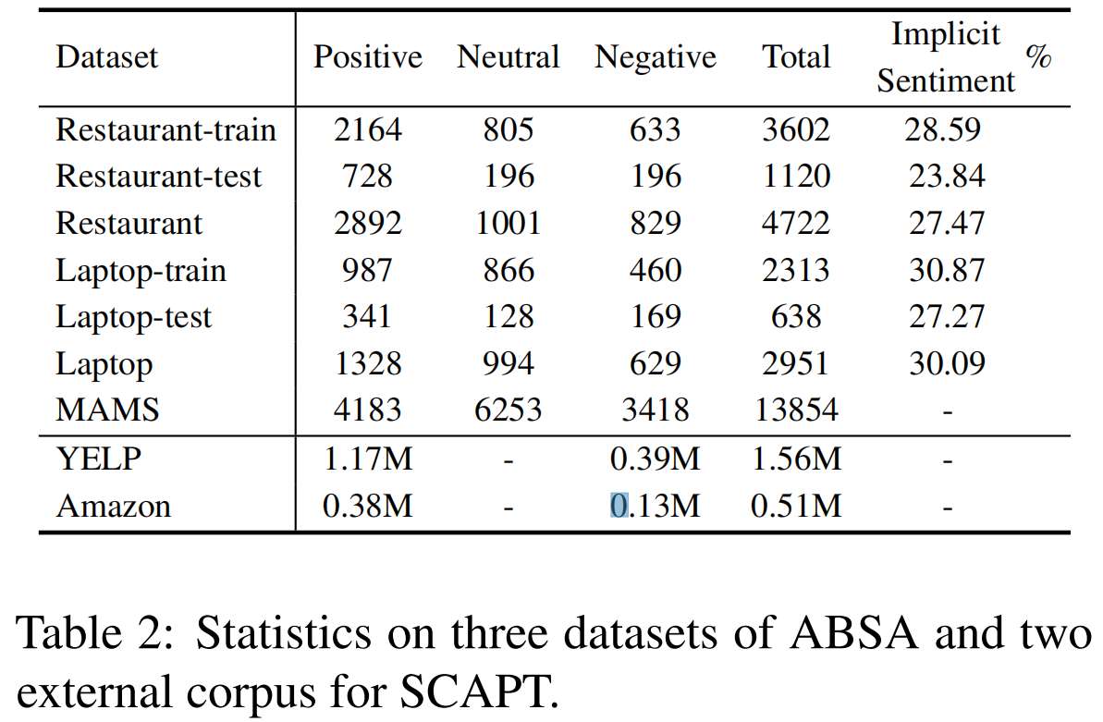
Background
Specifically, we adopt Yelp when dealing with Restaurant or MAMS, and Amazon for Laptop.

Slide 4
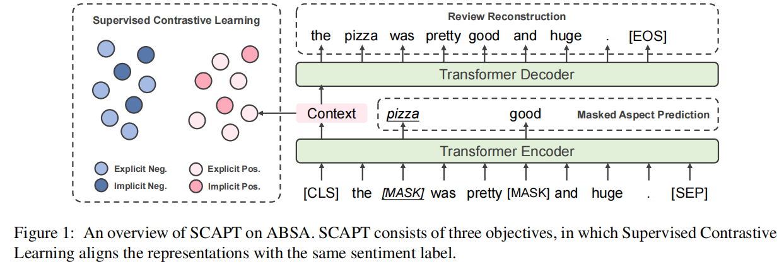
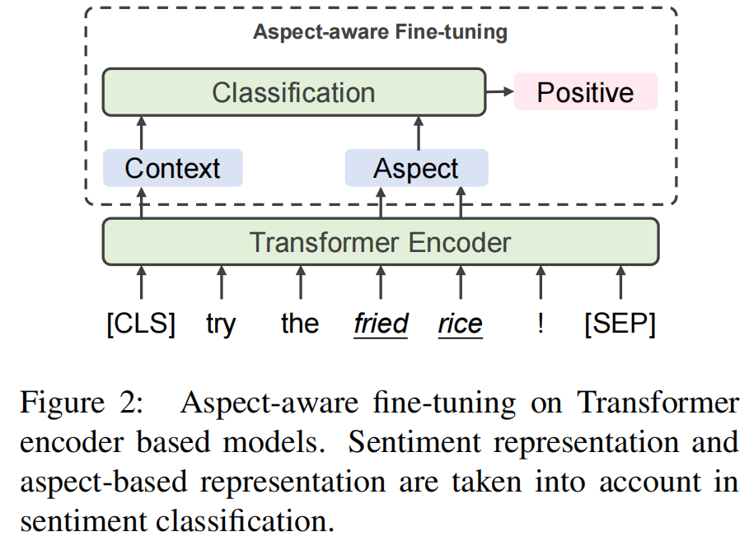
Method
Over view
Supervised Contrastive Pre-training
Aspect-Aware Fine-tuning
Specifically, we adopt Yelp when dealing with Restaurant or MAMS, and Amazon for Laptop.

Slide 5
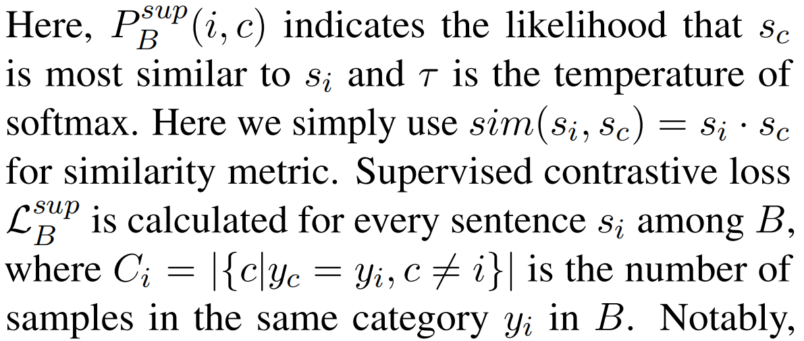
Method
Supervised Contrastive Pre-training
Transformer Encoder Backbone
Retrieved review corpus ,
the sentence is labeled with .
Formatting the input sentence as:
Supervised Contrastive Learning
For within a batch B, sentiment representation:

Slide 6
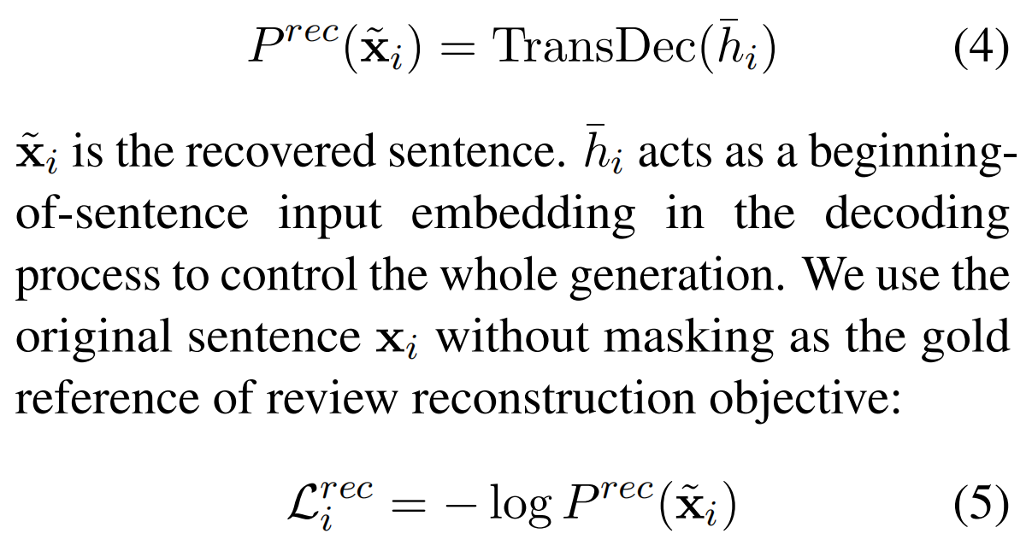
Method
Supervised Contrastive Pre-training
Review Reconstruction
Masked Aspect Prediction
Joint Training
Aspect Span Masking
Random Masking

Slide 7
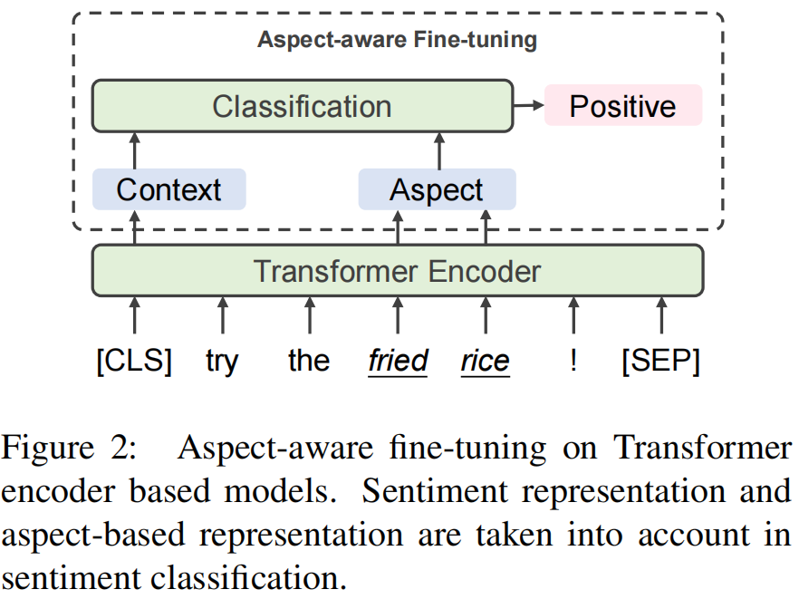
Method
Aspect-Aware Fine-tuning
Aspect-based Representation
Specifically, let be the token index in aspect ,
we average the hidden state for all to
acquire aspect-based representation:
Representation Combination

Slide 8
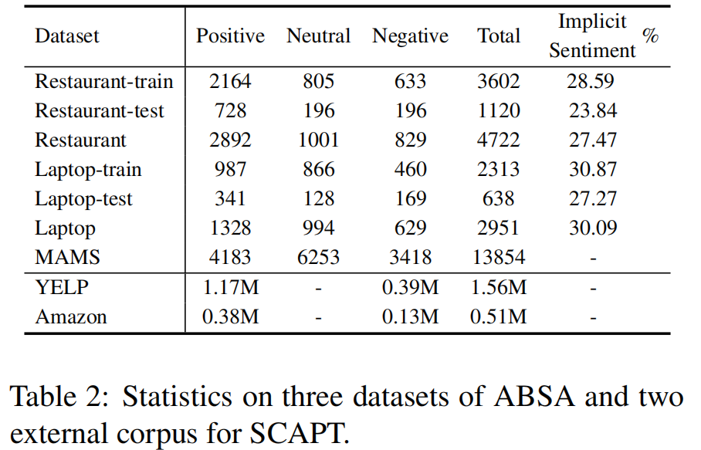
Experiment
Specifically, we adopt Yelp when dealing with Restaurant or MAMS,
and Amazon for Laptop.

Slide 9
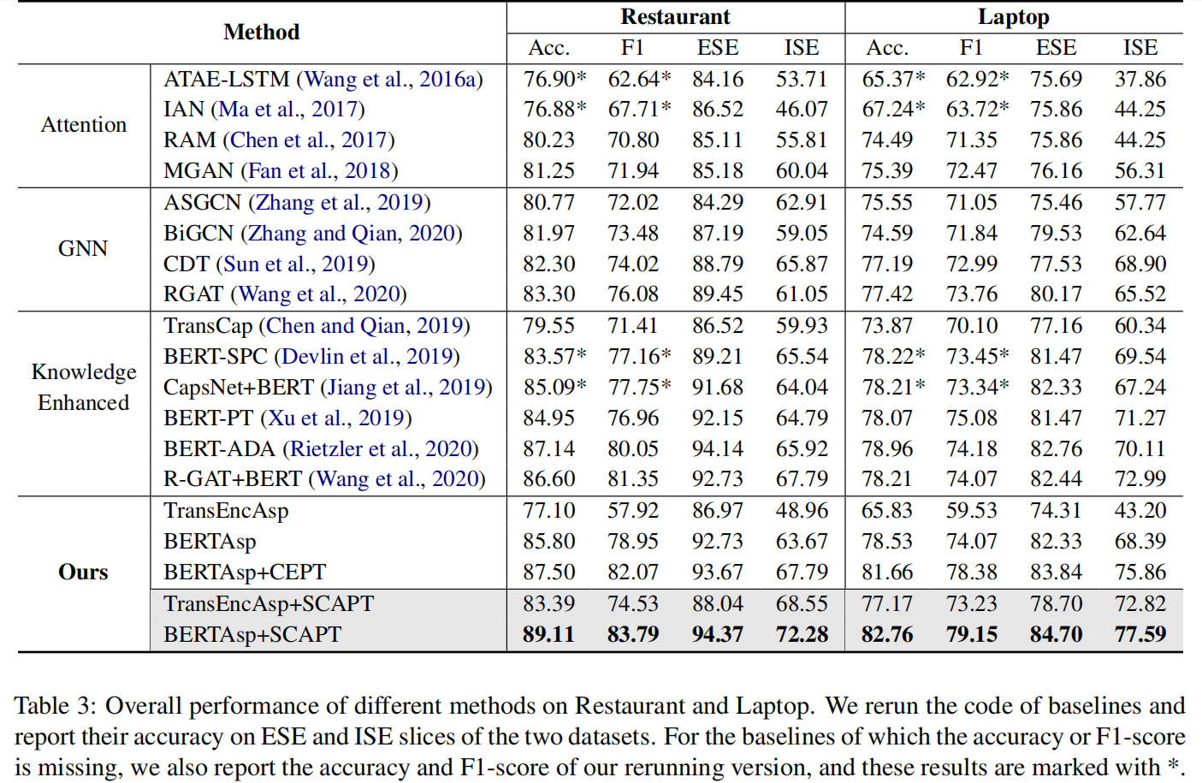
Experiment
TransEncAsp: Directly apply aspect-aware fine-tuning on randomly initialized Transformer encoder without pre-training.
BERTAsp: Directly apply aspect-aware fine-tuning on BERT-base.
• BERTAsp+CEPT: Merely replace the supervised contrastive learning loss with cross-entropy loss in SCAPT. Other settings are the same as BERTAsp+SCAPT.

Slide 10
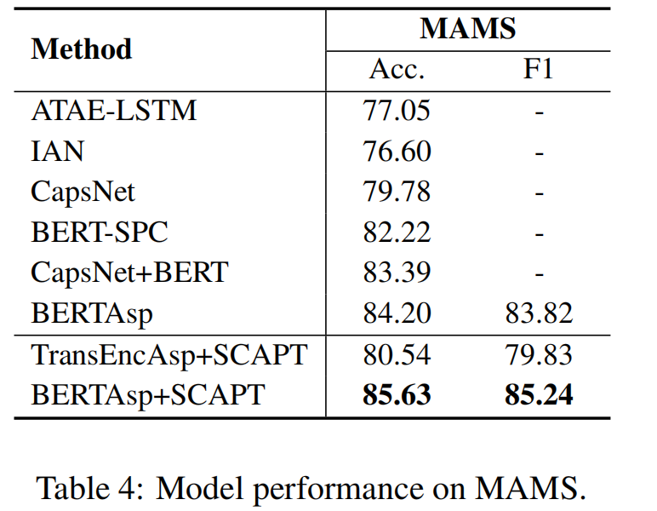
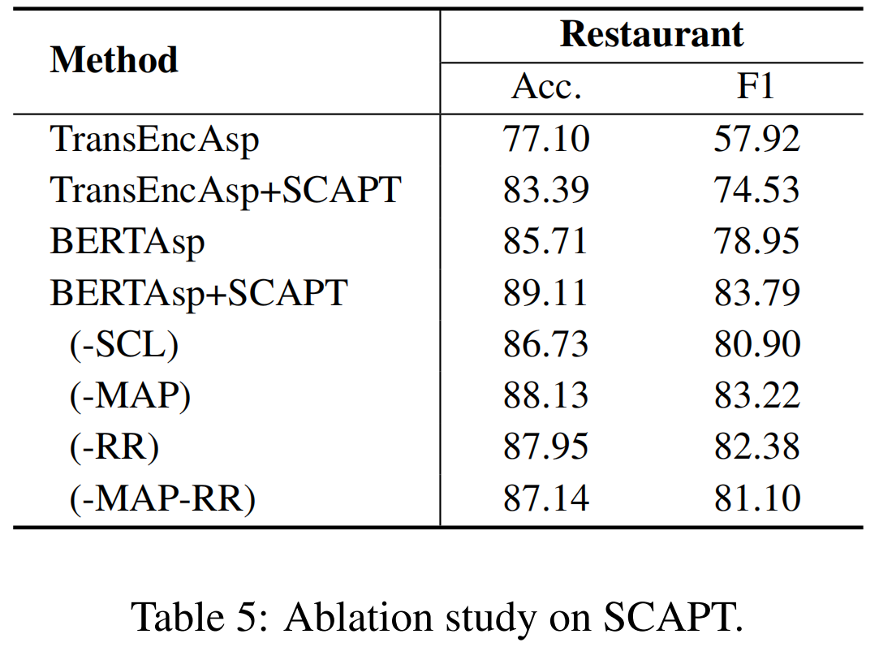
Experiment
Supervised Contrastive Learning loss (SCL)
Masked Aspect Prediction(MAP)
Review Reconstruction (RR)

Slide 11
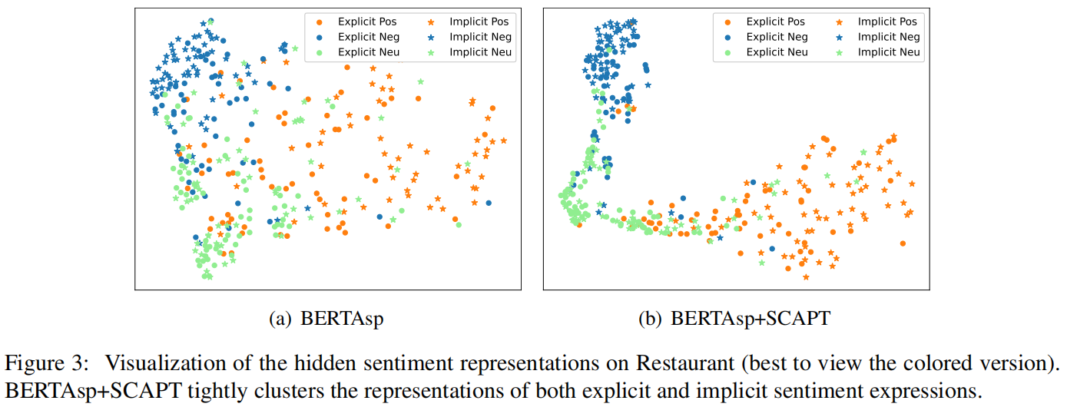
Experiment

Slide 12
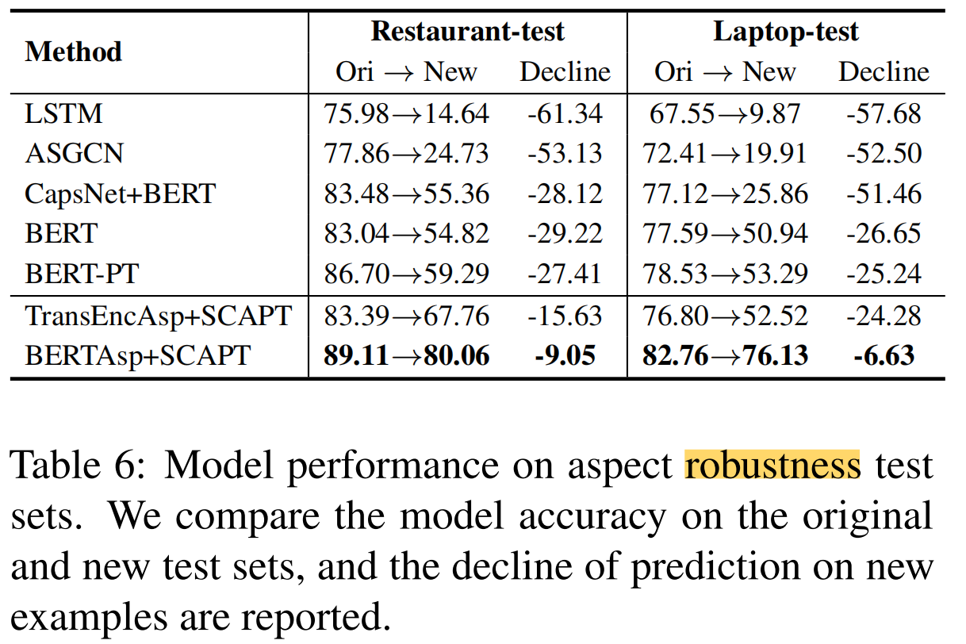
Experiment
Applying several perturbations on reviews from Restaurant and Laptop.
Introducing transformations from various linguistic perspectives.
The test sets are designed to probe whether models could distinguish the sentiment of the target aspect from the non-target aspects and unrelated information.

Slide 13
Chongqing University of Technology
ATAI
Advanced Technique of Artificial Intelligence
Chongqing University of Technology
Thank you!

